Slide 1
Yulee Band Parent Association, Inc
YBPA
BAND PARENTS MEETING 8/1/24 @6:00PM
Notes:
Let's get the meeting started

Slide 2
WELCOME
Evette
Band Parent Meetings: FIRST THURSDAY of every Month
Next Band Parent Meeting: September 5, 2024 at 6:00pm
Who We Are
Finances
Schedule
Helpful Info & Tips
Mr. Walker & Jordan Update
Ways to Support MS1

Slide 3
ARE YOU CONNECTED?
Evette
REMIND APP: @ms1band
OUR EMAIL LIST: YuleeBandParentAssociation@Gmail.com
FACEBOOK? https://www.facebook.com/groups/yhsband/
WEBSITE: http://yhsband.com
SOCIAL MEDIA: Instagram @yuleehornetbands
Ask a Board Member! Amanda, Jenn, Scott, Melody, Jason, or Evette

Slide 4
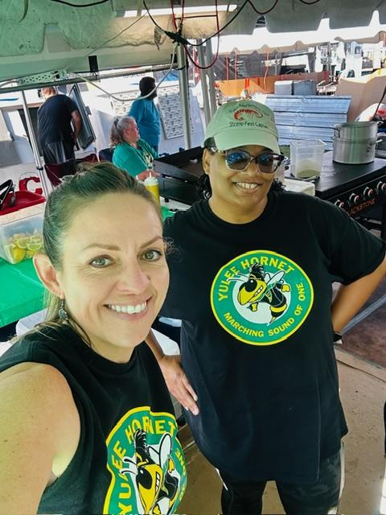
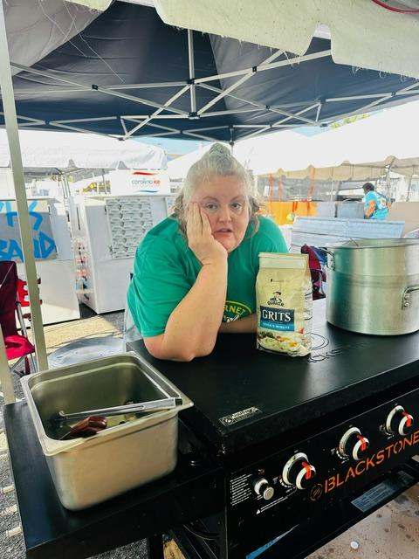
YBPA Board of Directors
Evette
President - Evette Fears
Treasurer - Jason Barker
Secretary - Jennifer Brooks
Director - Amanda Crider
Director - Scott English
Director - Melody Austin

Slide 5
Yulee Band Parent Association
Evette
We are a 501 3c Nonprofit.
We are a legal separate entity and do not work for the Nassau County or the school.
We provide Financial, Logistical, and Administrative Support to the Yulee High School Marching Band and other band-related programs.
We are volunteers and band parents.
Our goal is to ensure all band students have an Amazing Experience in MS1!
Who We Are & What We Do

Slide 6
THANK YOU
Evette
Melody Austin - Organizing Band Camp lunches
Scott, James, and others for Band room cleanup and equipment repair
Chelsea - Organizing Senior Banner Pictures
Jessica - Band Uniforms & Costumes
Volunteers - Various projects

Slide 7
FINANCES
Jason

Slide 9
Game Schedule
Amanda
HOME GAMES
8/23 @7PM vs Union County (1st Home game)
10/4 @7PM vs Parker (Homecoming)
10/11 @7PM vs Fernandina Beach (Battle of the Bridge)
10/18 @7PM vs Flagler (8th Grade Night)
10/25 @7PM vs Raines (Senior Night)
AWAY GAMES
8/16 @ 7PM vs Englewood
8/30 @7PM vs Clay
9/6 @730PM vs Charlton County (Band Will Not Travel)
9/13 No Game
9/20 @7PM vs West Nassau
9/27 @7PM vs Ribault
NOTE: All volunteers must sign up by Midnight on Wednesdays.

Slide 10
After - School Practices
Amanda
Practices are Tuesdays and Thursdays 3:45 pm until 7pm beginning next week!
Sections may have additional practice times
Football games are Friday Nights - call times will be announced
Competitions are on Saturdays

Slide 11
AWAY GAMES - What you need to know
Amanda
Ensure your child brings all uniform parts to school at the call time along with money for food/drinks at half-time and a snack for longer trips.
There will be two parent chaperones on every bus who will take attendance getting on the bus and check kids out to the parents after the game. They will have water and health/sign out paperwork.
EVERY PARENT IS A CHAPERONE AT THE GAME. If you are attending and see an issue with a Band member please help.
Sometimes the band stops for food and bathroom breaks on the way home - make sure you are signed up on REMIND to be in loop as to the arrival time.

Slide 12
Amanda
Competition Schedule
9/28 - Tocoi Creek Marching Invitational -
10/12 - Fleming Island HS - Fleming Island
10/19 - Orange Park High School - Orange Park, FL
11/2 MPA – Location TBD
11/8 - 11/10 - State Finals - Orlando (Overnight Trip: Please plan for additional $25 for hotel expenses for your student. Will likely be a 2 night trip Fri-Sun)

Slide 13
Save the Date!
Amanda
December 2024: Yulee Christmas Parade
Jazz Band will perform at Dickens
March 2024: Band Trip (destination TBD, estimated cost of $500
per student to be due in Oct and Dec payments)
May 2025: Shrimp Festival - our major, primary fundraiser for
the next year!

Slide 14
Helpful Info & Tips
Jenn
Things You Need to Know

Slide 15
Things to BUY!!
Jenn
Order your SWAG!!
Show Shirts - expected to go on sale in September
Garment Bags - if you need one order now
Parent Shirts - Gold and Black available (small and medium being ordered)
Senior Banners - if your child is a senior…
Order at: yhsband.com
Remember - We Do not Take Cash!!! Please pay online or by check.

Slide 16
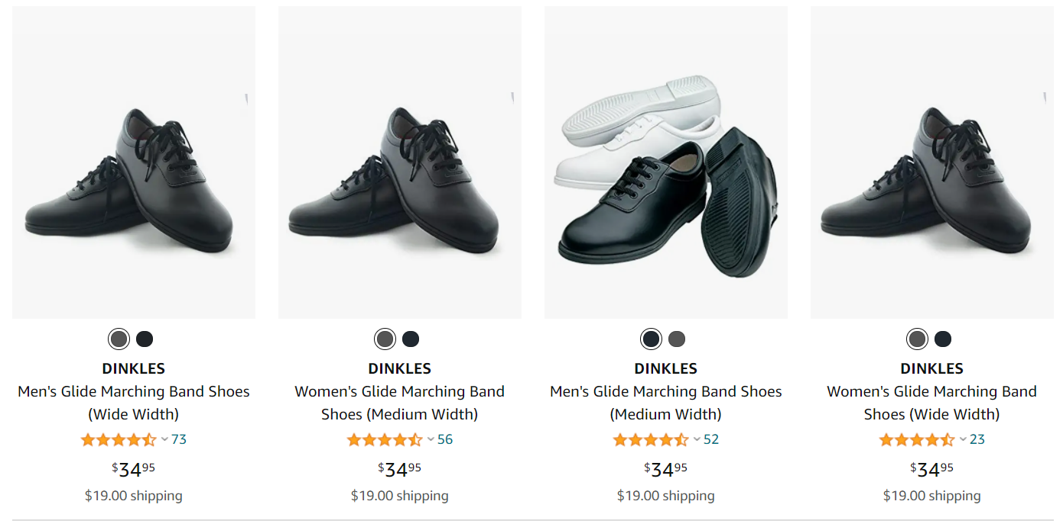
ORDER YOUR DINKLES
Jenn
Search “DINKLES GLIDE MARCHING SHOE” on Amazon
Or https://bandshoesonline.com/ You want BLACK MATTE (not grey)

Slide 17
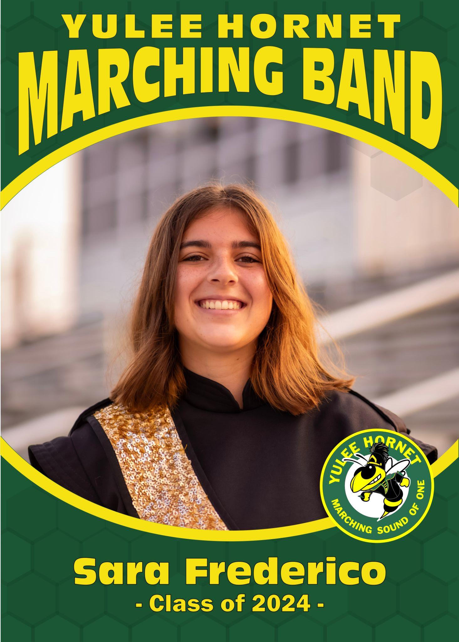
SENIOR
BANNERS
Jenn
Current Fastsigns estimate is approx $85/senior.
Jenn is currently looking to see if there are other options, but not sure if they would be done in time.
Banners are not paid for by the boosters.
Banners are 30”wide x 48” tall
Seniors will keep banner at end of season.
We are working to have them by the 1st home game on 08/23/24.
Proofs link was posted on the facebook group already. I will be making another FB post to confirm picture and correct spelling. Let us know if we need to make changes asap!
We will post a link on the Website SWAG section for payment.

Slide 18
Donations or Payments
Jenn
All donations and payments go directly to Yulee Band Parent Association
Online, Check or Money Order Only. NO CASH!
Mr. WALKER DOES NOT HANDLE MONEY
PLEASE DO NOT BRING MONEY INTO THE SCHOOL DO NOT HAND MR. WALKER MONEY OR CHECKS FOR ANY REASON UNLESS EXPLICITLY ASKED

Slide 19
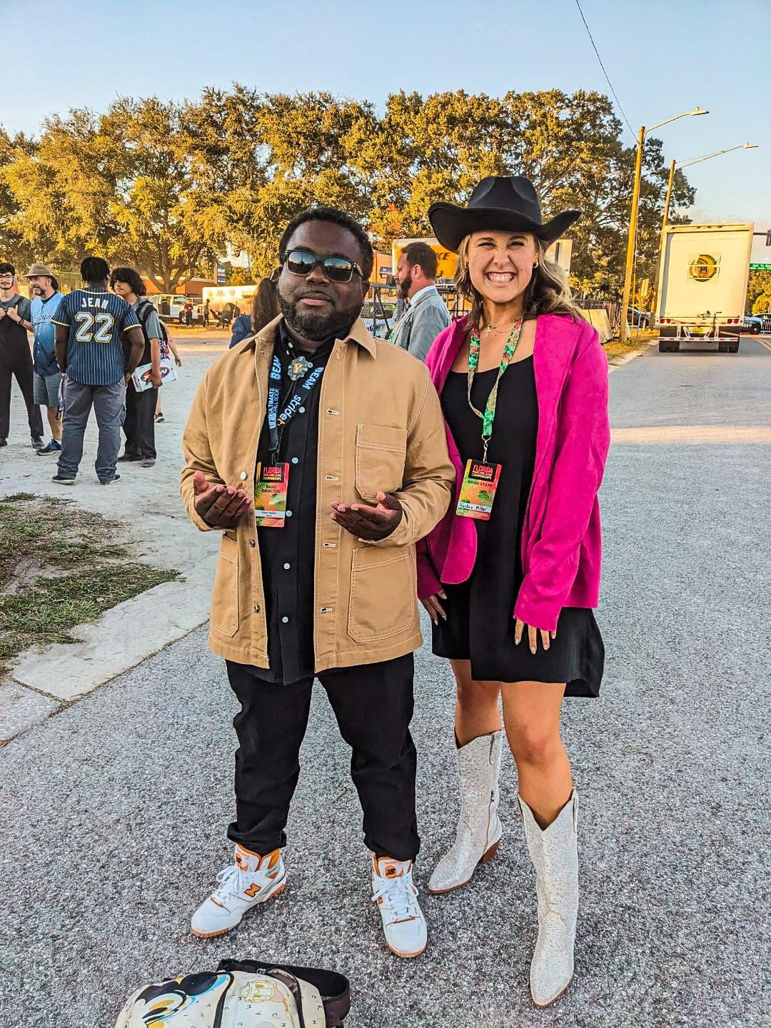
Mr. Walker &
Ms. Jordan

Slide 20
Info & Expectations
Walker & Jordan

Slide 21
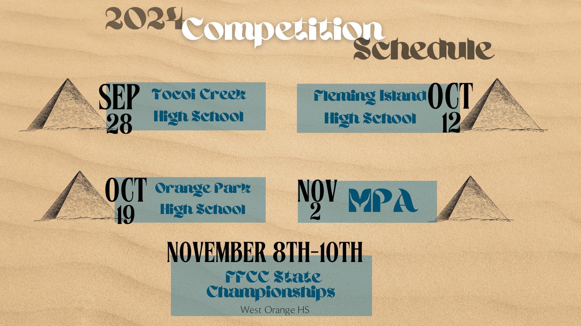
Info & Expectations
Walker & Jordan

Slide 22
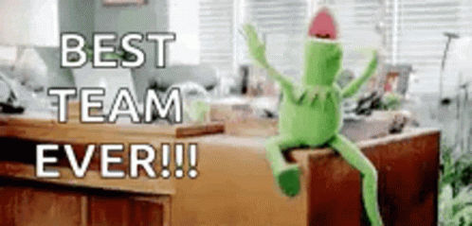
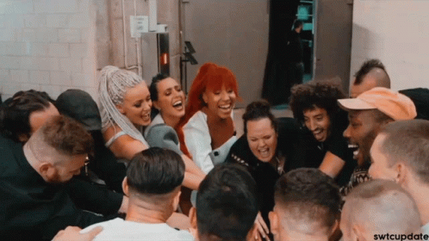
How You Can Support MS1
Evette

Slide 23
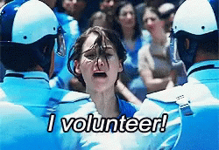
Volunteer Opportunities
Evette
Home Game Concessions
Sponsorships
Chaperones - Away games, Competitions, Band Trips
Events - Banquets & Dinners
Uniforms
Field Props & Equipment Repair
Transportation (Band Trailer) - Truck with towing ability needed
Media
Photography
Fundraising

Slide 24
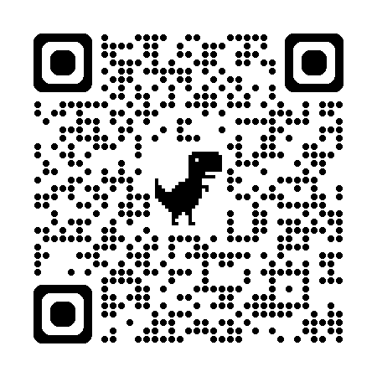
Volunteer
Info/Link
Or on our website YHSBand.com
Evette

Slide 25
QUESTIONS???
Evette

