Slide 1
Yulee Band Parent Association, Inc
YBPA
BAND PARENTS MEETING 9/5/24 @6:00PM
Notes:
Let's get the meeting started

Slide 2
WELCOME
Evette
Band Parent Meetings: FIRST THURSDAY of every Month
Next Band Parent Meeting: October 3, 2024 at 6:00pm
Finances
Concessions/Volunteer Reports
Upcoming Schedule
Mr. Walker & Jordan Updates
Ways to Support MS1

Slide 3
ARE YOU CONNECTED?
Evette
REMIND APP: @ms1band
OUR EMAIL LIST: YuleeBandParentAssociation@Gmail.com
FACEBOOK? https://www.facebook.com/groups/yhsband/
WEBSITE: http://yhsband.com
SOCIAL MEDIA: Instagram @yuleehornetbands
Ask a Board Member! Amanda, Jenn, Scott, Melody, Jason, or Evette

Slide 4
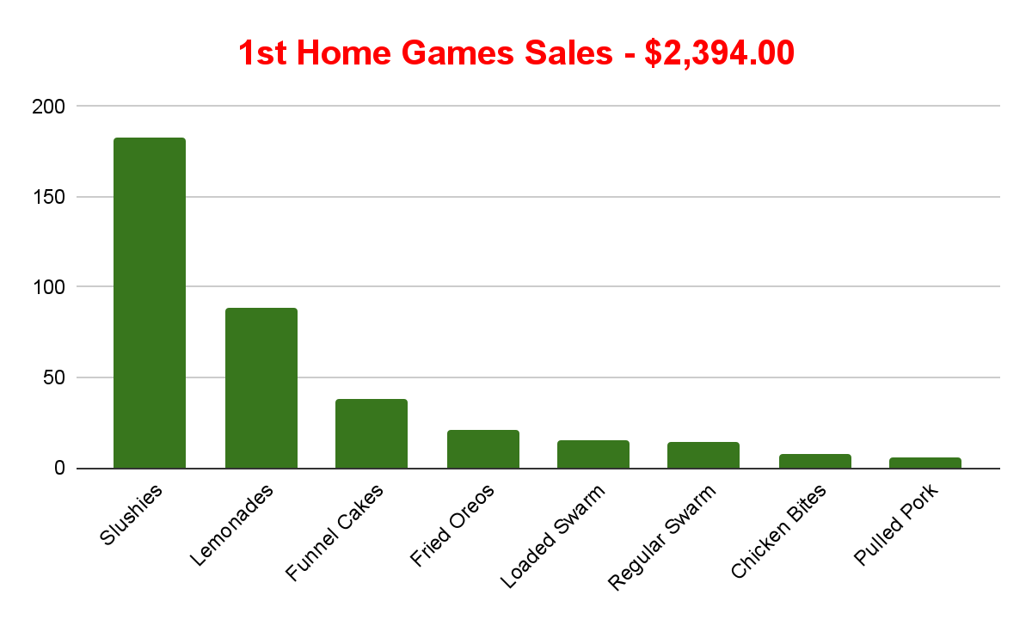
Concessions & Volunteer Reports
Evette
We had 34 Volunteers (Not including Board members)
We served 183 Slushies (TOP SELLER)
89 lemonades (175 when include 85 band drinks)
38 Funnel Cakes
21 Fried Oreos
15 Loaded Swarm Tots
14 Swarm Tater Tots (99 when include band meals)
8 Chicken Bites (93 whe include band meals)
6 Pulled Pork Sandwiches
How Did We Do?

Slide 5
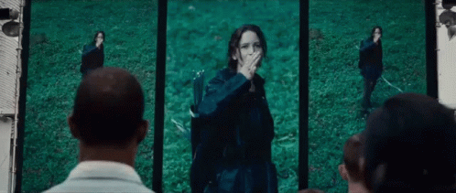
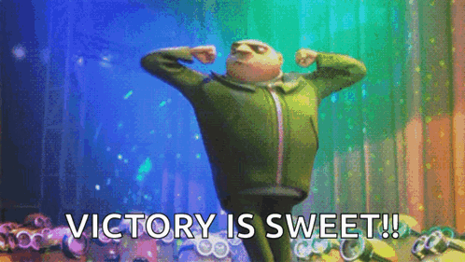
THANK YOU
TO ALL OF OUR AMAZING
VOLUNTEERS
Evette

Slide 6
FINANCES
Jason
Balance July 31: $94,317.03
Income Summary ($3,879.36): Fair Share, Sale of Band Shirts and Hoodies, Concessions
Expense Summary ($11,455.05): Check 1015 ($5,104.80 final payment for uniforms to Nassau County- outstanding item from last year’s budget), Senior Banners, Staff Items, Administrative Fees, Concession Supplies ($1,6311.11), Generator ($1,049.00), Uniforms, Flags, Competition Registration Fees, Student T-Shirts ($1,158.01)
Balance Aug 30: $86,741.34
Upcoming expenses: Staff Stipend #1 ($9,750), Insurance Renewal

Slide 8
Game Schedule
Amanda
HOME GAMES
8/23 @7PM vs Union County (1st Home game)
10/4 @7PM vs Parker (Homecoming & Alumni Night))
10/11 @7PM vs Fernandina Beach (Battle of the Bridge)
10/18 @7PM vs Flagler (8th Grade Night)
10/25 @7PM vs Raines (Senior Night)
AWAY GAMES
8/16 @ 7PM vs Englewood
8/30 @7PM vs Clay
9/6 @730PM vs Charlton County (Band Will Not Travel)
9/13 No Game
9/20 @7PM vs West Nassau
9/27 @7PM vs Ribault
NOTE: All volunteers must sign up by Midnight on Wednesdays.

Slide 9
Amanda
Competition Schedule
9/28 - Tocoi Creek Marching Invitational
10/12 - Fleming Island HS - Fleming Island
10/19 - Orange Park High School - Orange Park, FL
11/2 MPA – Location TBD
11/8 - 11/10 - State Finals - Orlando (Overnight Trip: Please plan for additional $25 for hotel expenses for your student. Will likely be a 2 night trip Fri-Sun)

Slide 10
Save the Date!
Amanda
December 2024: Yulee Christmas Parade
Jazz Band will perform at Dickens
March 2024: Band Trip (destination TBD, estimated cost of $500
per student to be due in Oct and Dec payments)
May 2025: Shrimp Festival - our major, primary fundraiser for
the next year!

Slide 11
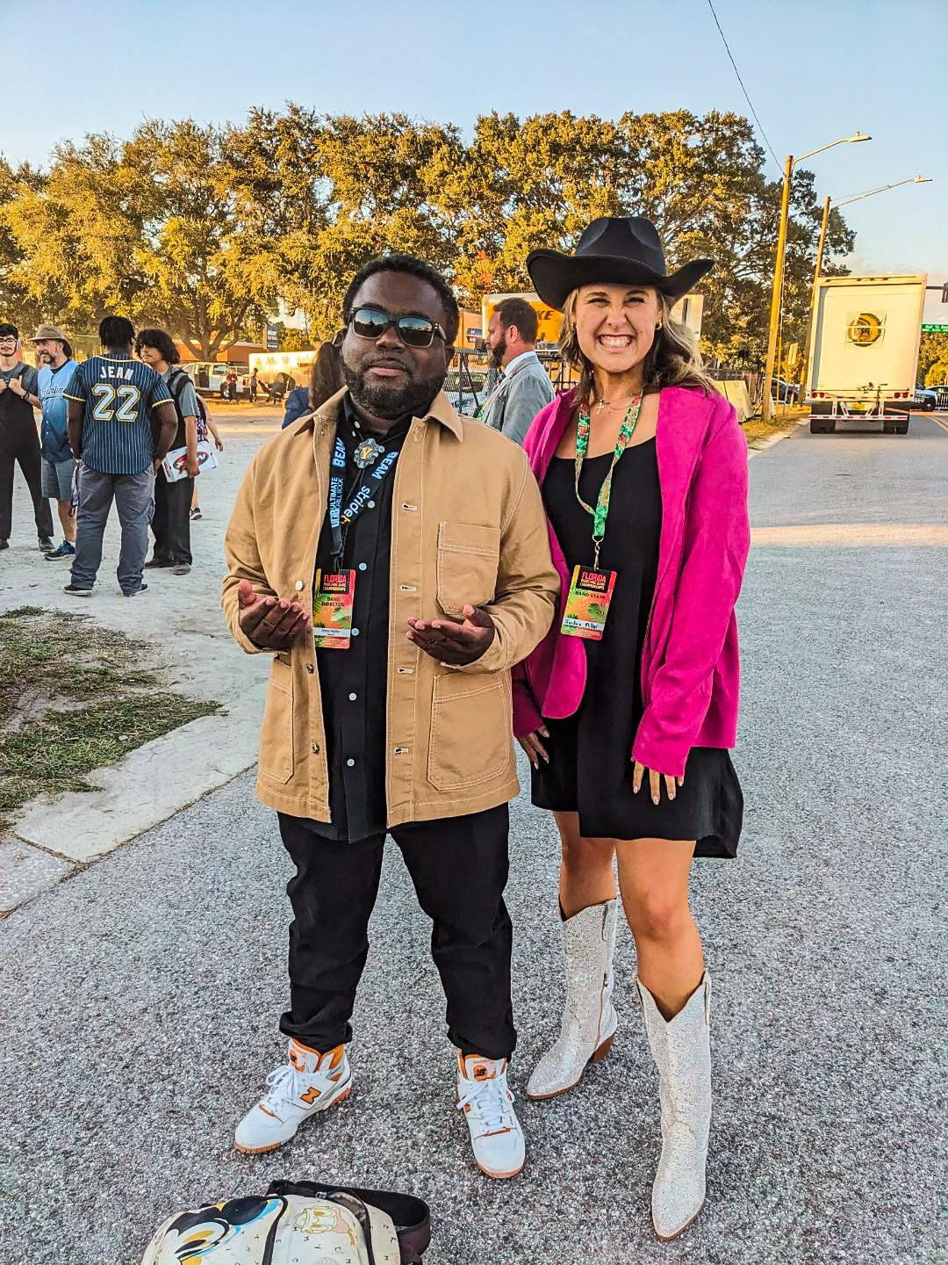
Mr. Walker &
Ms. Jordan

Slide 12
Info & Expectations
Walker & Jordan

Slide 13
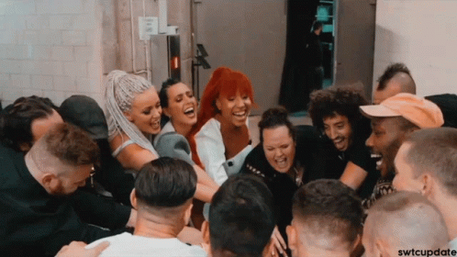
How You Can Support MS1
Evette

Slide 14
Sponsorships & Fundraising
Evette
Things You Need to Know

Slide 15
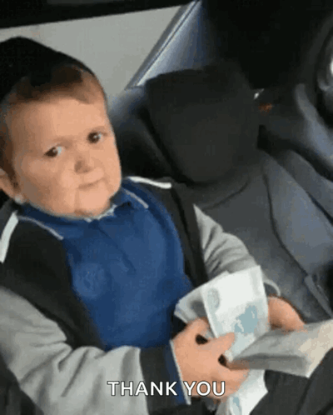
Corporate Sponsorships
Evette
Talk to every business you patronize about sponsoring MS1
(Doctor offices, daycares, churches, walmart, beauty salons, small business owners you know, etc)
Give them the Sponsorship Packet
Follow Up

Slide 16
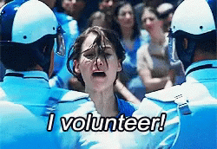
Volunteer Opportunities
Evette
Home Game Concessions
Sponsorships
Chaperones - Away games, Competitions, Band Trips
Events - Banquets & Dinners
Uniforms
Field Props & Equipment Repair
Transportation (Band Trailer) - Truck with towing ability needed
Media
Photography
Fundraising

Slide 17
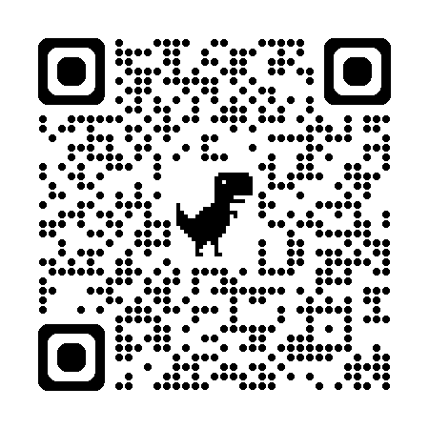
Volunteer
Info/Link
Or on our website YHSBand.com
Evette

Slide 18
QUESTIONS???
Evette

